Slide 1
RTL Design Example

Slide 2
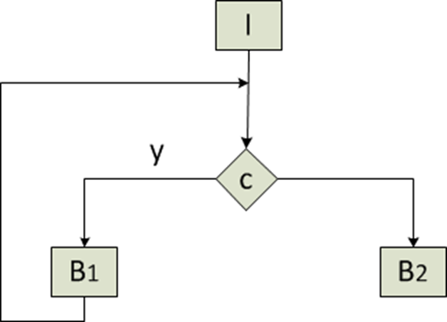
Working with an example
Example: 2nd order differential equation solver
Diffeq: (x, dx, u, a, clock, y)
input: x, dx, u, a, clock;
output: y
while(x < a)
u1 = u-(3*x*u*dx)-(3*y*dx);
y1 = y+(u*dx);
x1 = x+dx;
x = x1, y = y1, u = u1;
end
CDFG

Slide 3
Preprocessing
Example: 2nd order differential equation solver
Diffeq: (x, dx, u, a, clock, y)
input: x, dx, u, a, clock;
output: y
while(x < a)
u1 = u-(3*x*u*dx)-(3*y*dx);
y1 = y+(u*dx);
x1 = x+dx;
x = x1, y = y1, u = u1;
end
I
Read(p1, dx)
Read(p2, x)
Read(p3, a)
Read(p1,y)
Read(p2, u)
c = x < a
B₁
V₁ : t₁ = u * dx
V₂ : t₂ = 3 * x
V₃ : t₃ = 3 * y
V₄ : t₄ = u * dx
V₅ : t₅ = t₁ * t₂
V₆ : t₆ = t₃ * dx
V₇ : t₇ = u – t₅
V₈ : u = t₇ – t₆
V₉ : y = y + t₄
V₁₀ : x = x + dx
V₁₁ : c = x < a
B2
Write(p1, y)
Basic Blocks with 3-address codes
Control and Dataflow graph (CDFG)

Slide 4
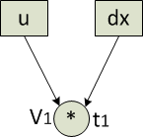
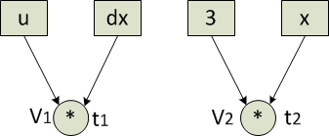
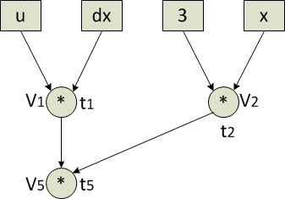
Preprocessing
B₁
V₁ : t₁ = u * dx
V₂ : t₂ = 3 * x
V₃ : t₃ = 3 * y
V₄ : t₄ = u * dx
V₅ : t₅ = t₁ * t₂
V₆ : t₆ = t₃ * dx
V₇ : t₇ = u – t₅
V₈ : u = t₇ – t₆
V₉ : y = y + t₄
V₁₀ : x = x + dx
V₁₁ : c = x < a

Slide 5
Preprocessing
B₁
V₁ : t₁ = u * dx
V₂ : t₂ = 3 * x
V₃ : t₃ = 3 * y
V₄ : t₄ = u * dx
V₅ : t₅ = t₁ * t₂
V₆ : t₆ = t₃ * dx
V₇ : t₇ = u – t₅
V₈ : u = t₇ – t₆
V₉ : y = y + t₄
V₁₀ : x = x + dx
V₁₁ : c = x < a
a
Date dependency graph

Slide 6
Scheduling

Slide 7
Register Allocation and Binding
R₁: t₁, t₃, t₆
R₂: t₂, t₅, t₇
R₃: t₄
R₄: t₈
R₅: u
R₆: x
R₇: dx
R₈: y
R₉: c
R₁₀: 3
R₁₁: a
Interval graph

Slide 8
FU Allocation and Binding: Multiplier
MULT: M₁: V₁, V₅
MULT: M₂: V₂, V₃
MULT: M₃: V₄, V₆
Mult operations with non-overlapping schedule
can be mapped to the same Multiplier FU

Slide 9
FU Allocation and Binding: Adder
FU allocation and Binding
A1: v10, v9, v7, v6
Add/Sub operations with non-overlapping
schedule can be mapped to the same adder FU

Slide 10
Functional Unit Allocation and Binding
FU alloc and bind:
MULT: M₁: V₁, V₅
MULT: M₂: V₂, V₃
MULT: M₃: V₄, V₆
ADD: A₁: V₇, V_{8,} V₉, V₁₀
COMP: C₁: V₁₁

Slide 11
Register Transfer Level (RTL) Behaviour
S₁:
V₁ : t₁ = u * dx
V₂ : t₂ = 3 * x
V₄ : t₄ = u * dx
V₁₀ : x = x + dx
S₂:
V₅ : t₅ = t₁ * t₂
V₃ : t₃ = 3 * y
V₉ : y = y + t₄
R₁: t₁, t₃, t₆
R₂: t₂, t₅, t₇
R₃: t₄
R₄: t₈
R₅: u
R₆: x
R₇: dx
R₈: y
R₉: c
R₁₀: 3
R₁₁: a
S₁:
V₁ R₁ = R₅ <M₁> R₇
V₂ R₂ = R₁₀ <M₂> R₆
V₄ R₃ = R₅ <M₃> R₇
V₁₀ R₄ = R₆ <A> R₇
S₂:
V₅ R₂ = R₁ <M₁> R₂
V₃ R₁ = R₁₀ <M₂> R₈
V₉ R₈ = R₈ <A> R₃
FU alloc and bind:
MULT: M₁: V₁, V₅
MULT: M₁: V₂, V₃
MULT: M₁: V₄, V₆
ADD: A₁: V₇, V_{8,} V₉, V₁₀
COMP: C₁: V₁₁
FU mapping
Original behaviour
Register mapping
RTL behaviour

Slide 12
Datapath Synthesis
R1, R2, R1, R5, R4
R6, R1, R5, R6, R2
FU
R1, R1, R2, R7, R4

Slide 13
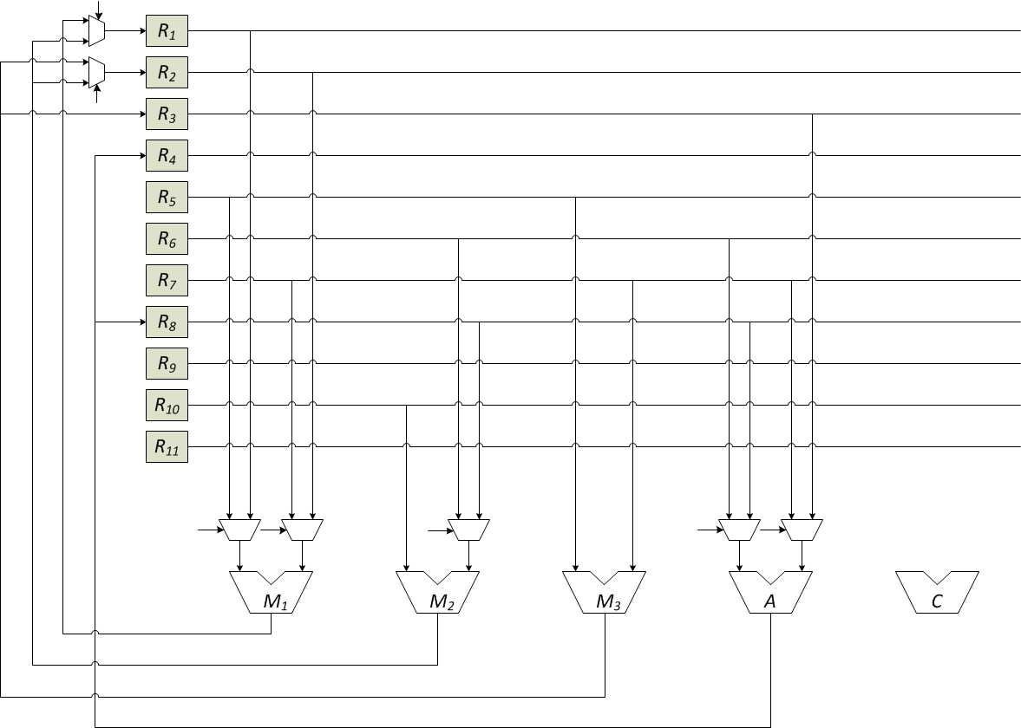
Data path Synthesis
S₁:
V₁ R₁ = R₅ <M₁> R₇
V₂ R₂ = R₁₀ <M₂> R₆
V₄ R₃ = R₅ <M₃> R₇
V₁₀ R₄ = R₆ <A> R₇
S₂:
V₅ R₂ = R₁ <M₁> R₂
V₃ R₁ = R₁₀ <M₂> R₈
V₉ R₈ = R₈ <A> R₃

Slide 14
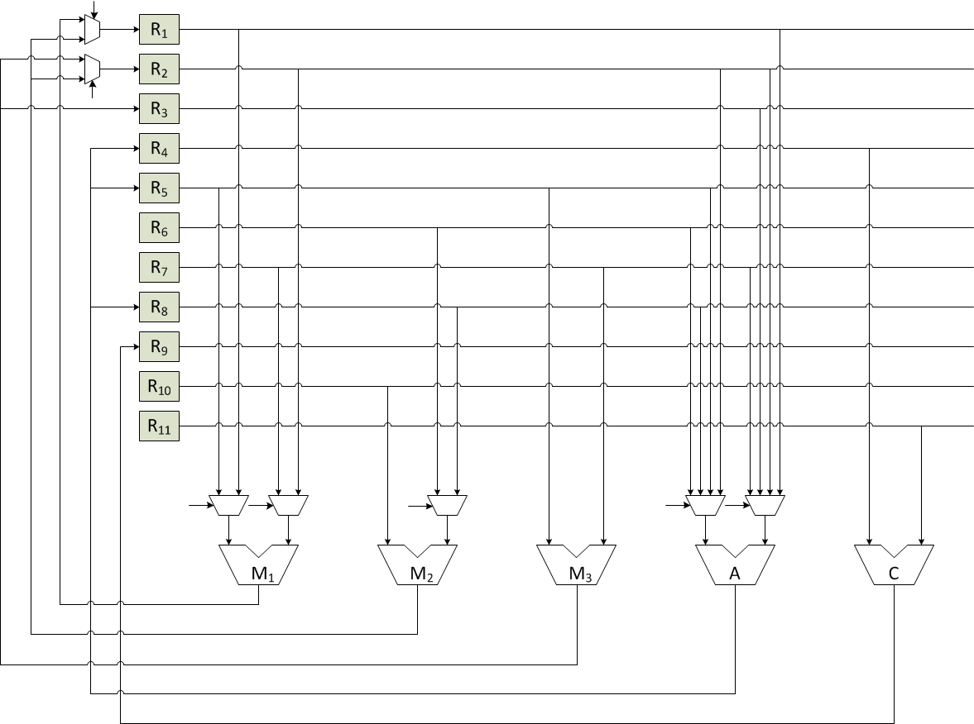
Data path Generation

Slide 15
Controller Synthesis
REGISTERS
a
enable
3
dx
x
y
u
r1
Mux control
r2
ALU control (+,-,<)
c
*
ALU
CONTROL-UNIT
DATA-PATH

Slide 16
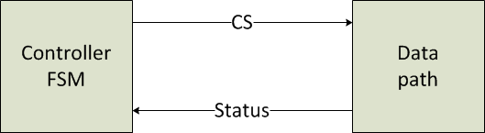
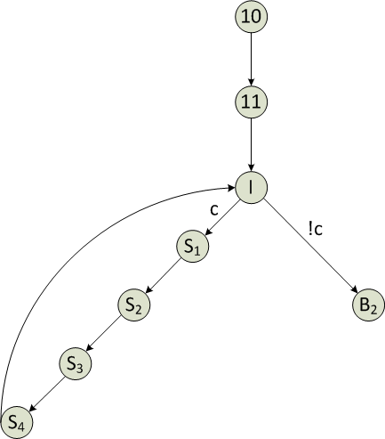
Final RTL
<1, 0, 0, 0, 0, 0, 0, 0, 1, 1, 1, 1, 0, 0, 0, 0, 0, 0 0, 0, 1>

Slide 17
Control Signals
Control Assertion Pattern: <FU, FU_MUX_in, Reg-en, Reg_Mux_in>
FU: 1 bit
FU_MUX_in: 7 bits
Reg_en: 11 bits
Reg_MUX_in: 2 bits
Total: 21 bits
S₁: <1, 0, 0, 0, 0, 0, 0, 0, 1, 1, 1, 1, 0, 0, 0, 0, 0, 0 0, 0, 1>
S₂: <1, 1, 1, 1, 0, 1, 0, 1, 1, 1, 0, 0, 0, 0, 0, 1, 0, 0 0, 1, 0>
S₃: <…..>
S₄: <…..>
S₁:
V₁ R₁ = R₅ <M₁> R₇
V₂ R₂ = R₁₀ <M₂> R₆
V₄ R₃ = R₅ <M₃> R₇
V₁₀ R₄ = R₆ <A> R₇
S₂:
V₅ R₂ = R₁ <M₁> R₂
V₃ R₁ = R₁₀ <M₂> R₈
V₉ R₈ = R₈ <A> R₃

